Slide 1
Motion Sensors
Seeing the unseen

Slide 2
Physical Security
If a physical device can be reached, this bypasses a lot of security measures
Password hashes can be broken without any alarms being tripped
Encryption only lasts for a certain length of time
Theft

Slide 3
Mitigating Factors
Door locks
Motion sensors
Cameras
Security guards

Slide 4
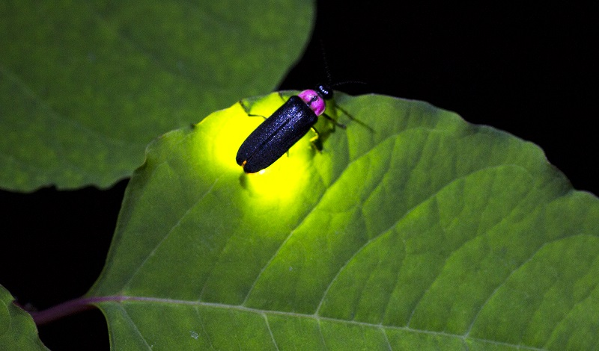
How do we see?
Animals that emit light are a lot more visible in the dark
Can you tell the direction of the sun with your eyes closed?

Slide 5
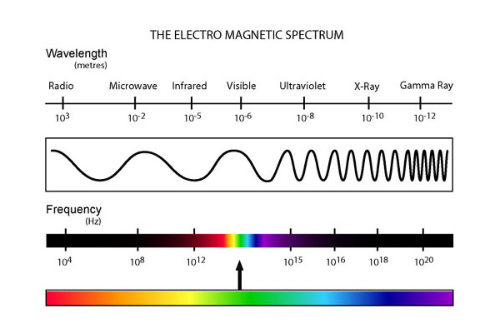
Infrared Light
Visible light makes up a small portion of possible wavelengths of light
Anything that is warm puts off infrared light

Slide 6
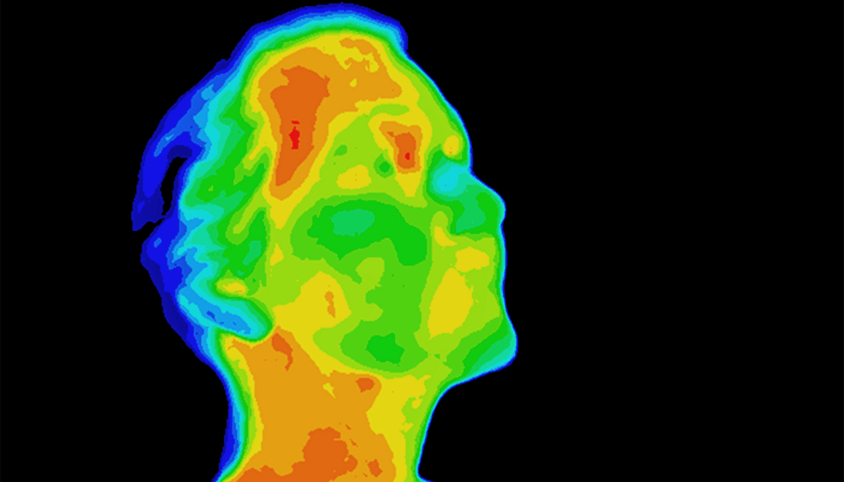
Glow-in-the-dark people
We do emit light, for those who care to look

Slide 7
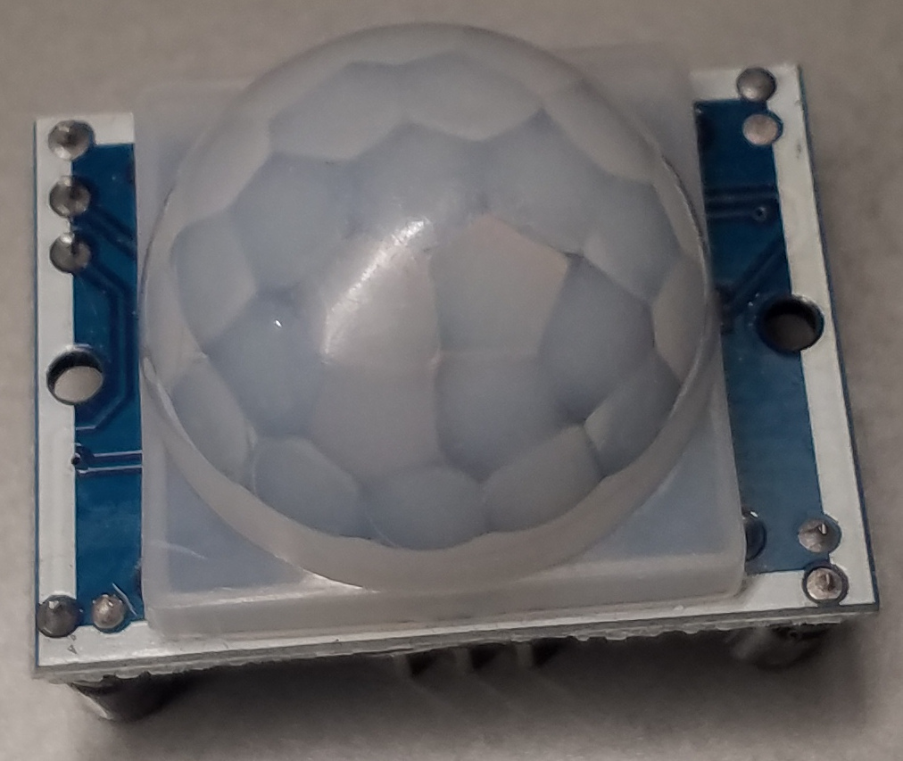
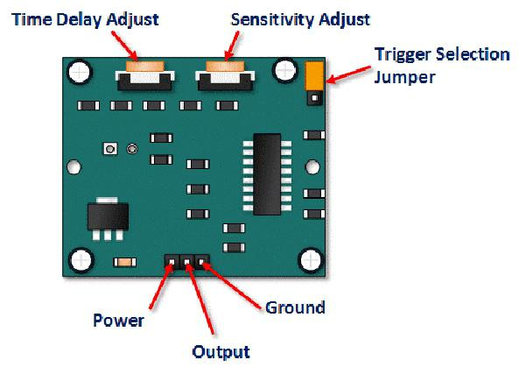
PIR Sensor (Passive Infrared)

Slide 8
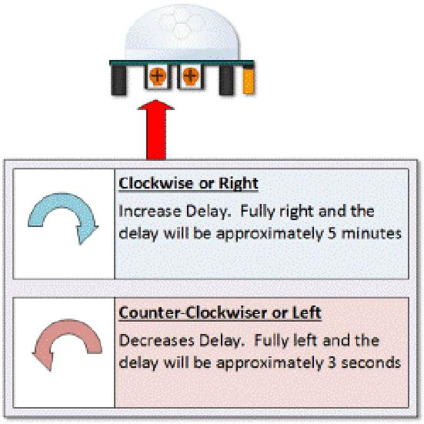
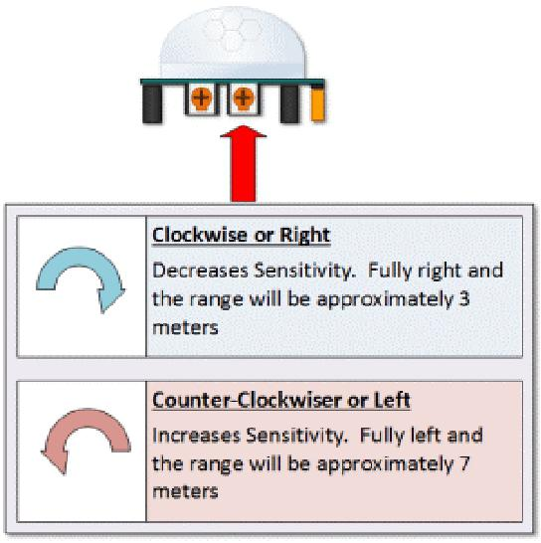
Making adjustments

Slide 9
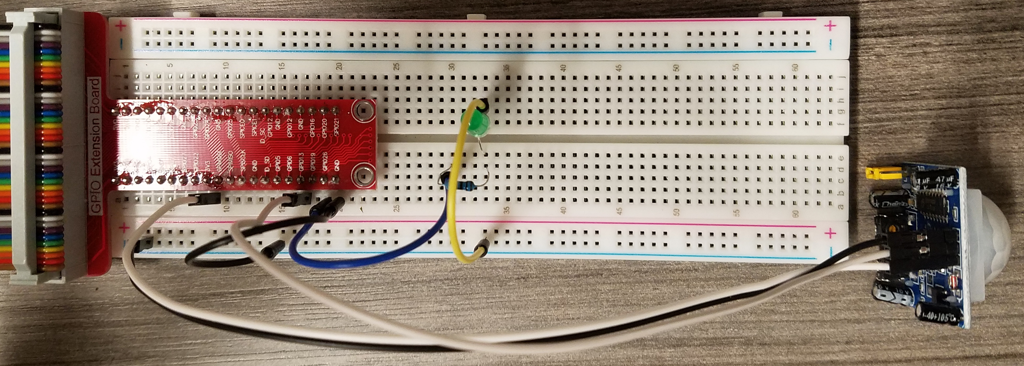
Sensor status
Connect sensor to GPIO 13
Connect LED to GPIO26
python3 motiondetect.py
Adjust the sensitivity

Slide 10
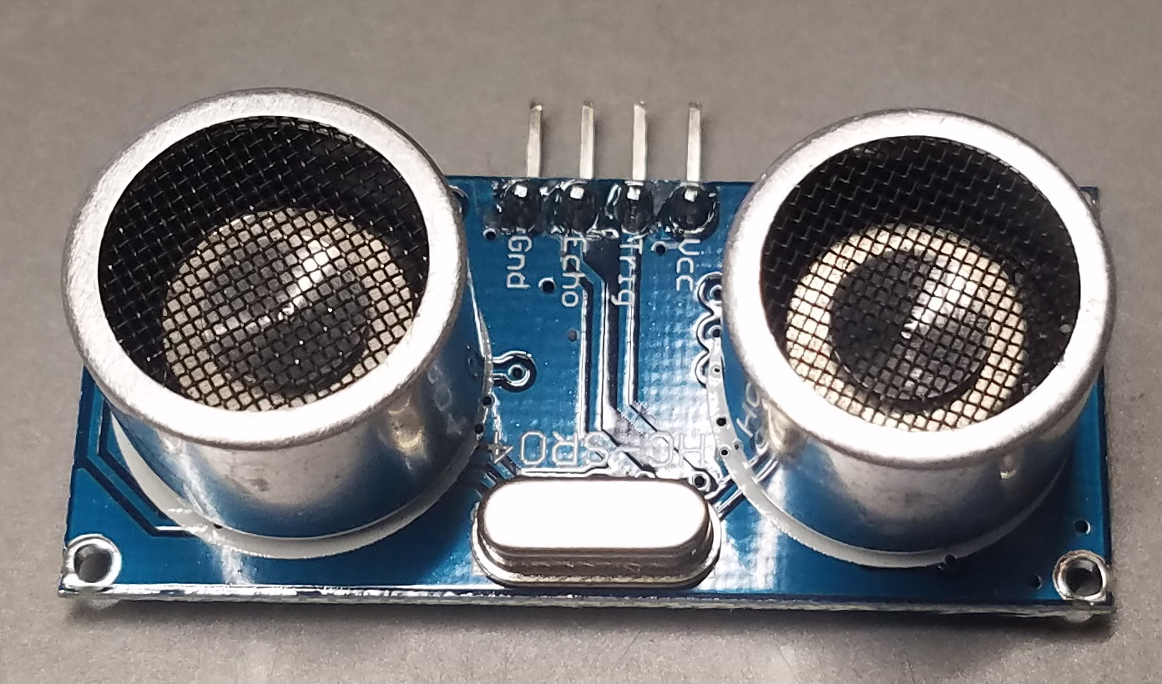
Ultrasonic sensor
Active (sends pings)
Waits for the sound to return
Uses trip time to determine distance

Slide 11
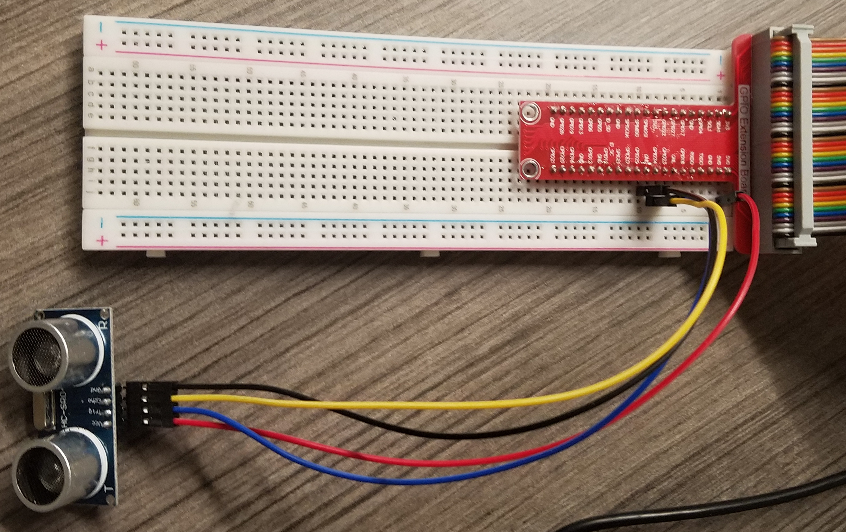
Connections
VCC to 5V
Echo and Trig to 23 and 24
Gnd to Gnd
python3 distanceSensor.py
Try changing max_distance
Try deflecting the ping

